Slide 1
VI Text Editor

Slide 2
VI IMproved
Commonly used text editor in Linux.
Used to edit all kinds of plain text
Useful for editing programs.
Most often Vim is started to edit a single file with the command:
vim file
More generally Vim is started with:
vim [options] [filelist]

Slide 3
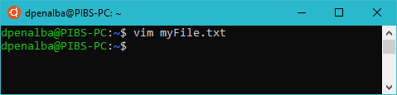
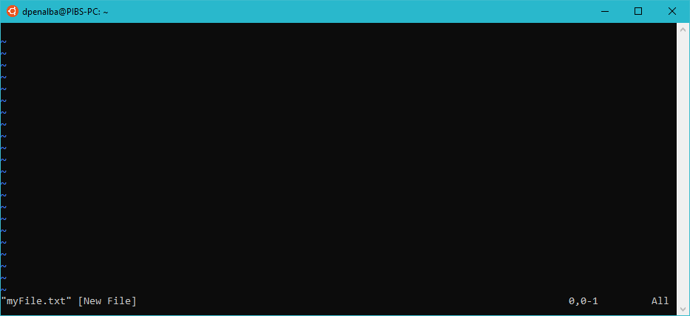
Command mode
To enter VI Text editor in command mode:
Command mode view:
In command mode, we can take user commands to:
Move the cursor.
Cut, copy and paste text.
Save changes to the file.
* Commands are case sensitive.

Slide 4
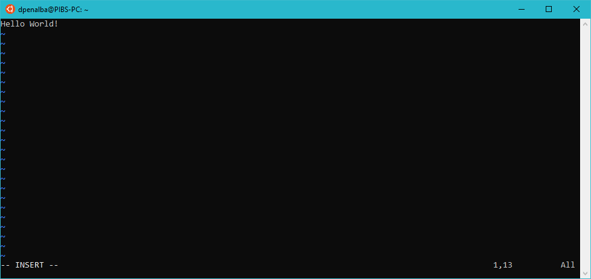
Insert mode
To go to insert mode press i and you can begin typing:
In insert mode we can edit text in the file. Any key will be taken as an input.
Press ESC to save changes and return to command mode.

Slide 5
Commands
Key | Action
i | Insert mode: Insert at cursor
a | Insert mode: write after cursor
A | Insert mode: write at end of line
ESC | Save changes and terminate insert mode
u | undo
U | undo changes to line
o | Insert mode: new line
dd 3dd | Delete line Delete 3 lines
D | Delete contents of line after the cursor

Slide 6
Cursor movement
Key | Action
k, ↑ | Cursor up
j, ↓ | Cursor down
h, ← | Cursor left
l, → | Cursor right

Slide 7
Saving or closing a file
Key | Action
Shift + zz, :wq | Save and quit
:w | Save and remain open
:q | Quit without saving

Slide 8
Saving or closing a file
Key | Action
Shift + zz, :wq | Save and quit
:w | Save and remain open
:q | Quit without saving

Slide 9
Exercise
Make a script using VI Text editor that will prompt the user to input name, email, username, and password. The password should be type in silent.
Add a message confirming the registration and will inform the user to verify the account. Include variables: name, email, username on the message.

Slide 10
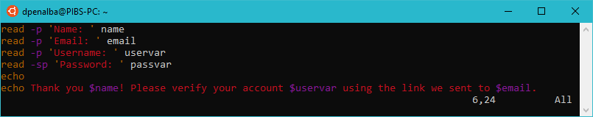
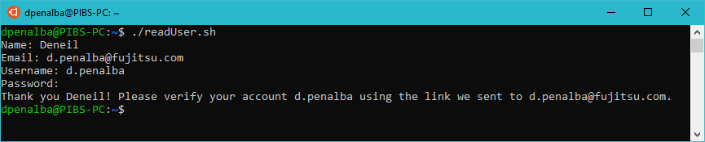
Solution
Script:
Output:

